Slide 1



Institute of Technology of Cambodia
Department of Information and Communication Engineering
Single Sign-On (SSO) System and DevOps
Student
Academic Supervisor Company Advisor
Duration
: Mr. ROTHA DAPRAVITH
: Mr. NOP PHEARUM
: Mr. VON SEYHA
: 19 February - 31 May 2024
Academic Year 2023-2024

Slide 2

I
GENRAL PRESENTATION
II
ANALYSIS AND DESIGN
I
TABLE OF CONTENTS
III
IMPLEMENTATION
IV
CONCLUSION
V
DEMONSTRATION

Slide 3





GENERAL PRESENTATION
ANALYSIS AND DESIGN
IMPLEMENTATION
CONCLUSION
DEMONSTRATION
I. GENERAL PRESENTATION
3

Slide 4

GENERAL PRESENTATION
ANALYSIS AND DESIGN
IMPLEMENTATION
CONCLUSION
DEMONSTRATION
1.1. General Presentation of Organization
The internship took place at the Ministry of Economy and Finance
The internship started from 19 February - 31 May 2024
Address
: St. 92, Sangkat Wat Phnom, Khan Daun Penh, Phnom Penh
: (+855) 97 252 8358
: legalconcilmef@gmail.com
: https://www.legalconcilmef.com/en
Tel
Email Website
The Legal Council of the Ministry of Economy and Finance was established in 2013 by Prâkas No. 290 SHV.BRK. It has been revised and modified by Sub-decrees No. 75 ANKR.BK, No. 488 ANKR.BK, and No. 76 ANKR.BK. Its purpose is to ensure legality, consistency, and harmonization in the drafting of legal texts, manage implementation effectively, and participate in the execution of the Public Financial Management Reform Program (PFMRP).
4

Slide 5
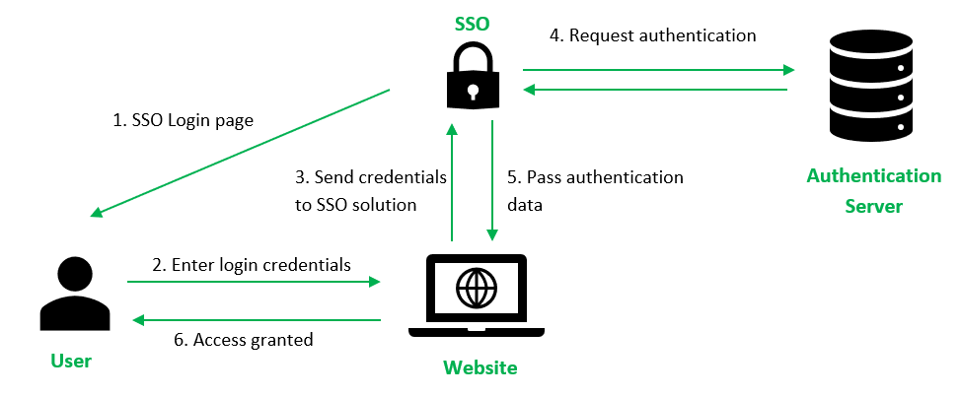
GENERAL PRESENTATION
ANALYSIS AND DESIGN
IMPLEMENTATION
CONCLUSION
DEMONSTRATION
1.2. Project Overview
What is Single Sign-On (SSO) System?
The Single Sign-On (SSO) System is an authentication method that allows users to access multiple applications with a single login. By logging in once, users can access all connected systems without needing to re-enter their credentials for each one. This simplifies the user experience, enhances security, and reduces password fatigue.
5

Slide 6


GENERAL PRESENTATION
ANALYSIS AND DESIGN
IMPLEMENTATION
CONCLUSION
DEMONSTRATION
1.3. Problems Overview
Frequent logins.
Password fatigue.
Scattered user data.
Data analysis difficulty.
IT management complexity.
1.4. Objective Overview
Centralized user management.
Single credentials.
Enhanced security.
Unified access.
Improved user experience.
6

Slide 7
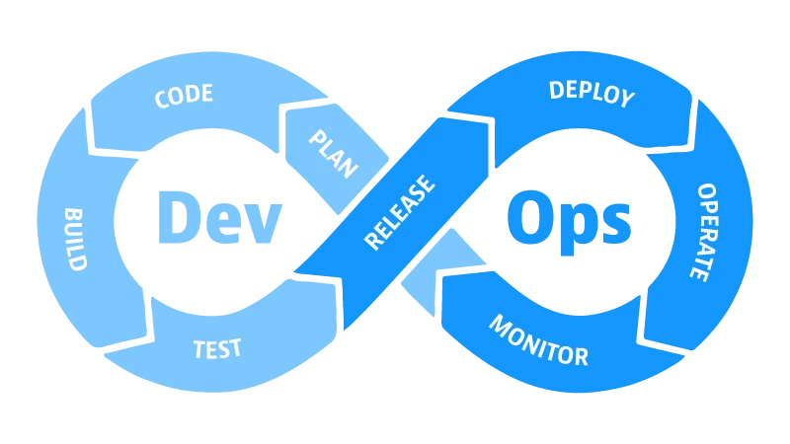
GENERAL PRESENTATION
ANALYSIS AND DESIGN
IMPLEMENTATION
CONCLUSION
DEMONSTRATION
1.5. DevOps Project Overview
What is DevOps ?
DevOps is a methodology that combines software development and IT operations to streamline workflows and enhance collaboration. It aims to shorten development cycles, increase deployment frequency, and deliver reliable software quickly and consistently, closely aligned with business goals. This approach emphasizes automation, continuous measurement, and rapid release cycles.
7

Slide 8

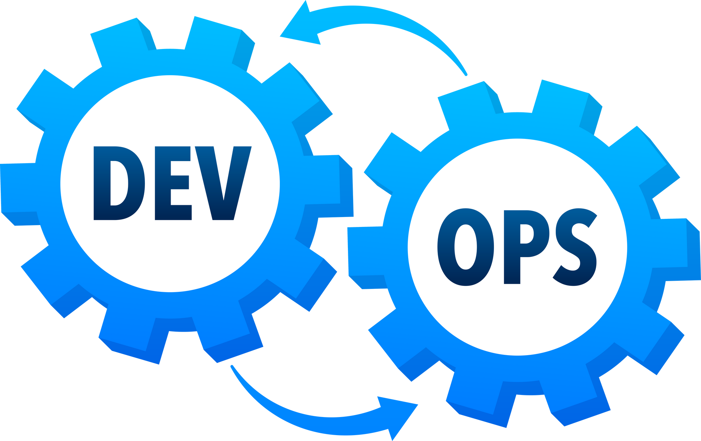
GENERAL PRESENTATION
ANALYSIS AND DESIGN
IMPLEMENTATION
CONCLUSION
DEMONSTRATION
1.6. Problems Overview
Slow development.
Siloed between development and operation team.
Deployment failures.
Unreliable environment.
1.7. Objective Overview
Faster development cycle.
Ehanced production quality.
Improved collaboration.
Reliable deployment.
8

Slide 9


GENERAL PRESENTATION
ANALYSIS AND DESIGN
IMPLEMENTATION
CONCLUSION
DEMONSTRATION
II. ANAYSIS AND DESIGN
9

Slide 10
GENERAL PRESENTATION
ANALYSIS AND DESIGN
IMPLEMENTATION
CONCLUSION
DEMONSTRATION
2.1. Project planning table
Tasks | Weeks | Weeks | Weeks | Weeks | Weeks | Weeks | Weeks | Weeks | Weeks | Weeks | Weeks | Weeks
Tasks | 1 | 2 | 3 | 4 | 5 | 6 | 7 | 8 | 9 | 10 | 11 | 12
Learn new technologies
Analysis project requirement & Database design
Implementation SSO keycloak
Learn and Implement DevOps
Maintainance and Testing
Deployment
Report
10

Slide 11


GENERAL PRESENTATION
ANALYSIS AND DESIGN
IMPLEMENTATION
CONCLUSION
DEMONSTRATION
2.2. Functionality for each roles
Administrator
Users
Manage logins, sessions, and system access.
Customize user interfaces and security settings.
Manage realms configurations and role assignments.
Handle user account registration and credentials.
Configure authentication flows and manage tokens.
Administer client and identity provider settings.
Enable user self-registration and account management.
Handle logins, logouts, and email verifications.
Update personal information and passwords.
Monitor device activity and secure logins with OTP.
Configure identity and service provider settings.
Track user activity and generate system reports.
6
11

Slide 12


GENERAL PRESENTATION
ANALYSIS AND DESIGN
IMPLEMENTATION
CONCLUSION
DEMONSTRATION
2.3. Functionality requirement for DevOps
Functionality requirement
Non-functionality requirement
Version Control.
Containerization.
Web-server configuration.
Continous Integration (CI).
Continous Deployment (CD).
Insfrastructure as Code (IaC).
Monitoring services.
Performance.
Scalability.
Reliability.
Security network.
Telegram for Alerting messages.
6
12

Slide 13
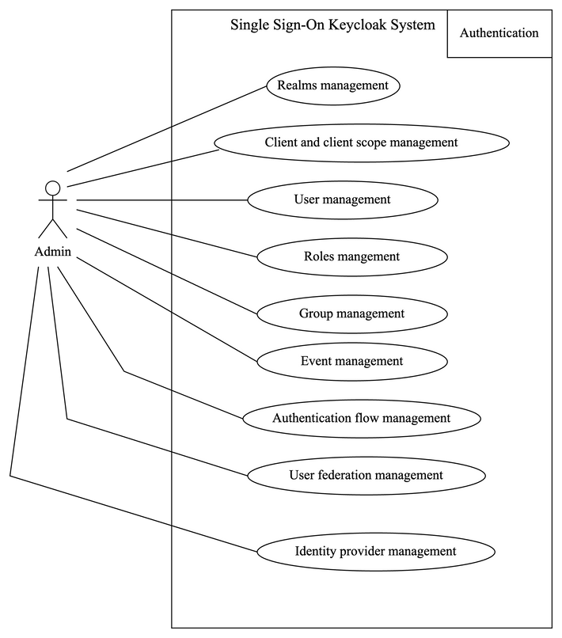
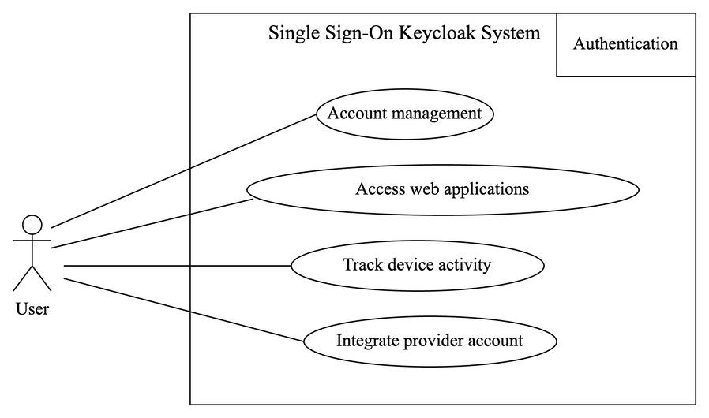
GENERAL PRESENTATION
ANALYSIS AND DESIGN
IMPLEMENTATION
CONCLUSION
DEMONSTRATION
2.4. Use Case Diagram
User role use case diagram
Admin role use case diagram
13

Slide 14
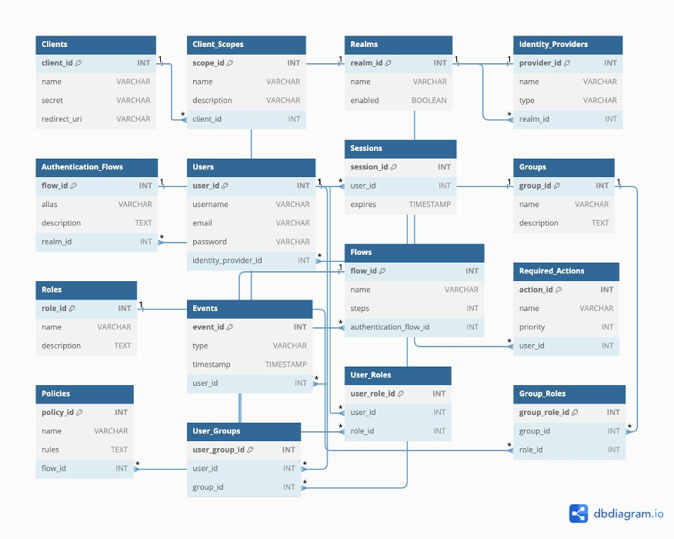
GENERAL PRESENTATION
ANALYSIS AND DESIGN
IMPLEMENTATION
CONCLUSION
DEMONSTRATION
2.5. Database Schema
14

Slide 15
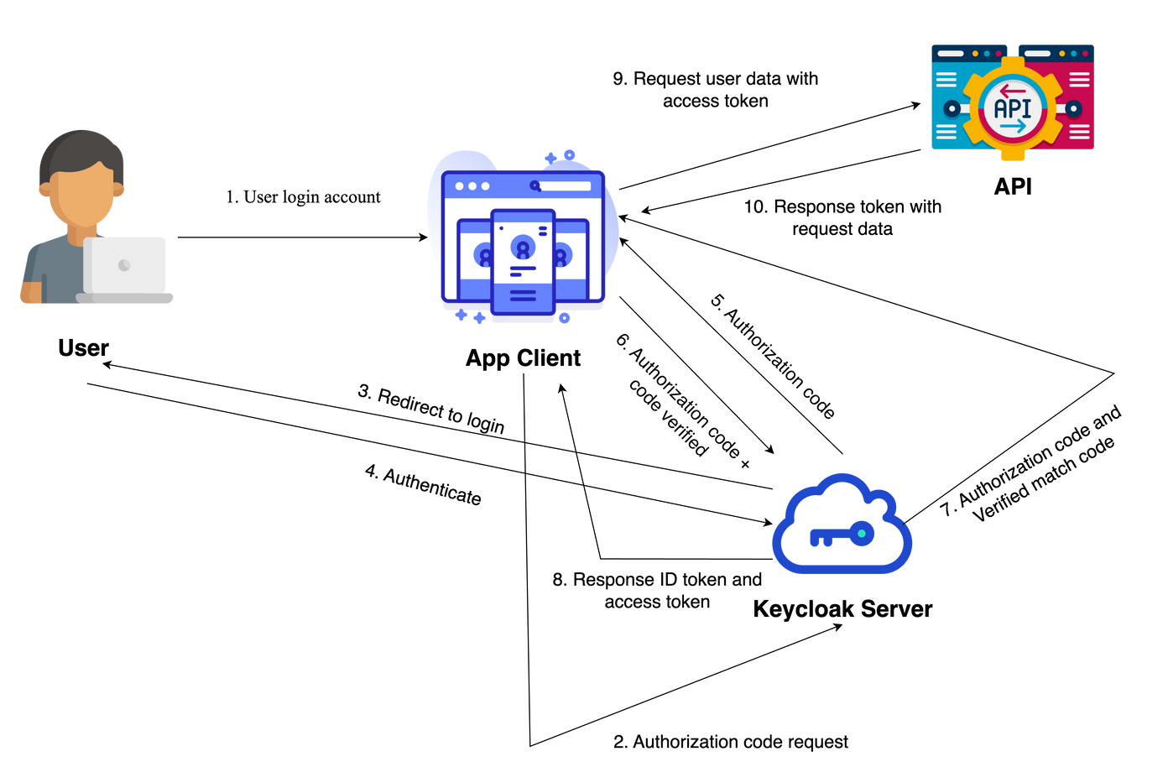
GENERAL PRESENTATION
ANALYSIS AND DESIGN
IMPLEMENTATION
CONCLUSION
DEMONSTRATION
2.6. Architecture diagram of SSO system
15

Slide 16
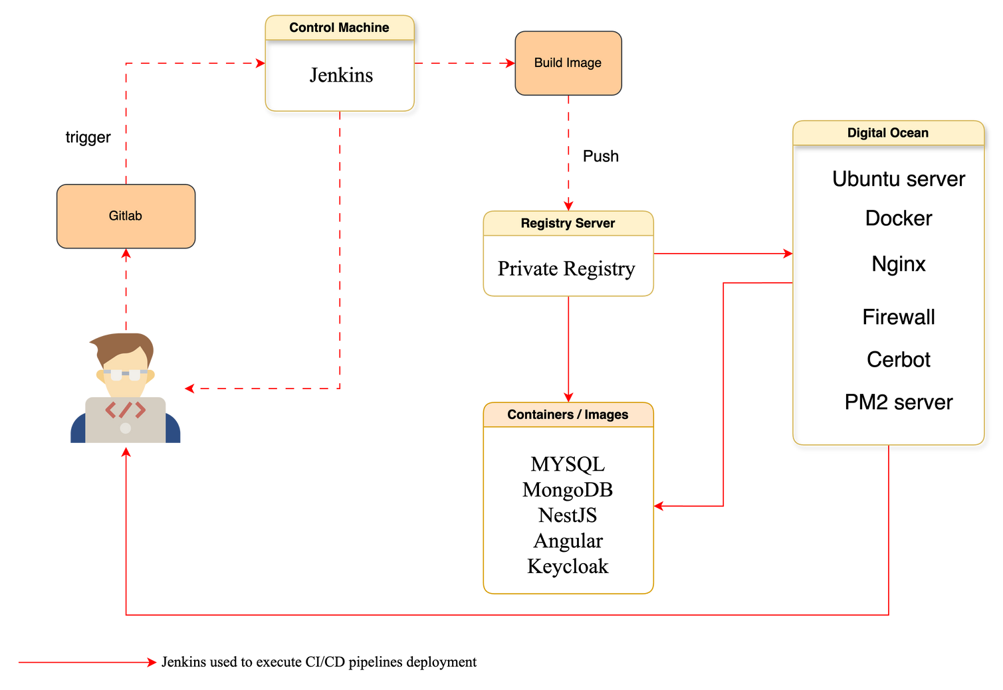
GENERAL PRESENTATION
ANALYSIS AND DESIGN
IMPLEMENTATION
CONCLUSION
DEMONSTRATION
2.7. Architecture diagram of DevOps
16

Slide 17


















GENERAL PRESENTATION
ANALYSIS AND DESIGN
IMPLEMENTATION
CONCLUSION
DEMONSTRATION
2.8.Choice of Technologies and Tools
Keycloak
Angular
Docker
Nginx
Jenkins
MySQL
MongoDB
Visual studio code
SSH
Termius
SourceTree
GitLab
Pm2 Server
Digital Ocean
Postman
Name.com
Draw.io
Telegram
17

Slide 18

GENERAL PRESENTATION
ANALYSIS AND DESIGN
IMPLEMENTATION
CONCLUSION
DEMONSTRATION
III. IMPLEMENTATION
18

Slide 19
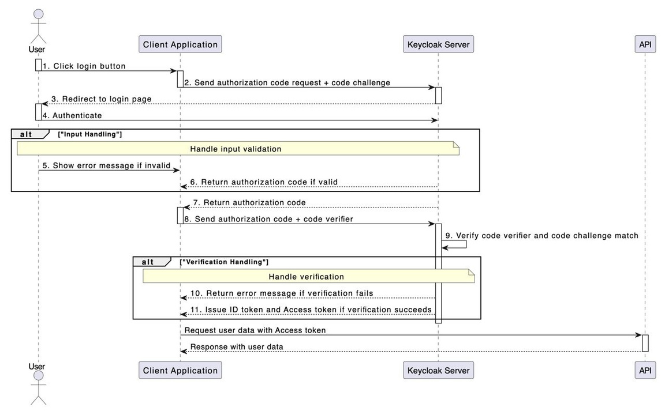
GENERAL PRESENTATION
ANALYSIS AND DESIGN
IMPLEMENTATION
CONCLUSION
DEMONSTRATION
3.1. Sequential Diagram for Authentication
19

Slide 20
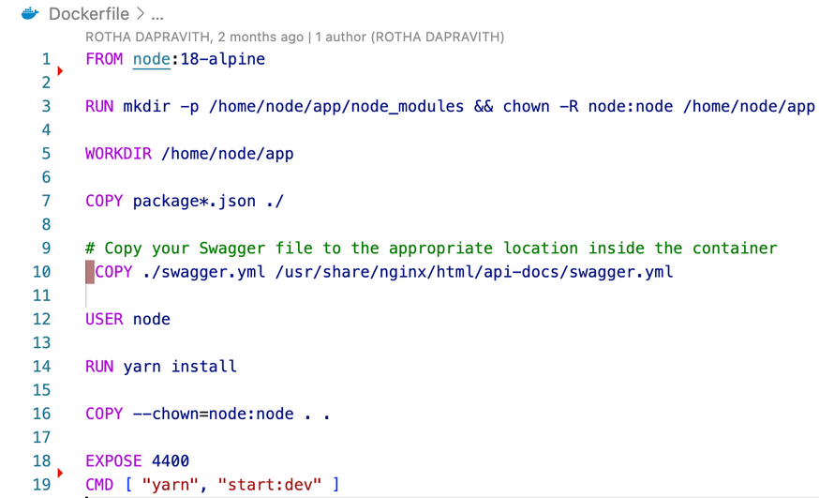
GENERAL PRESENTATION
ANALYSIS AND DESIGN
IMPLEMENTATION
CONCLUSION
DEMONSTRATION
3.2. DevOps Project Implementation
Build Docker file
Node,js environment version
insall a nest.js dependencies, and set the container port to serve port 4400 to running server and run the nest application using command `yarn start:dev` or `nest start --watch
20

Slide 21
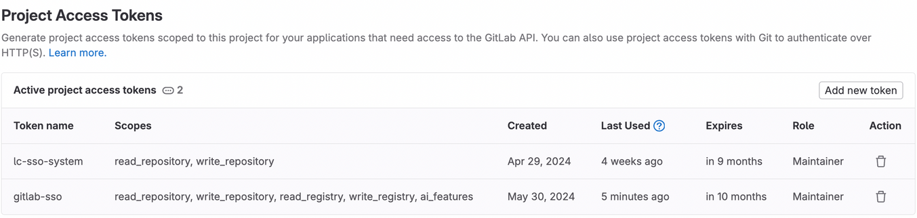
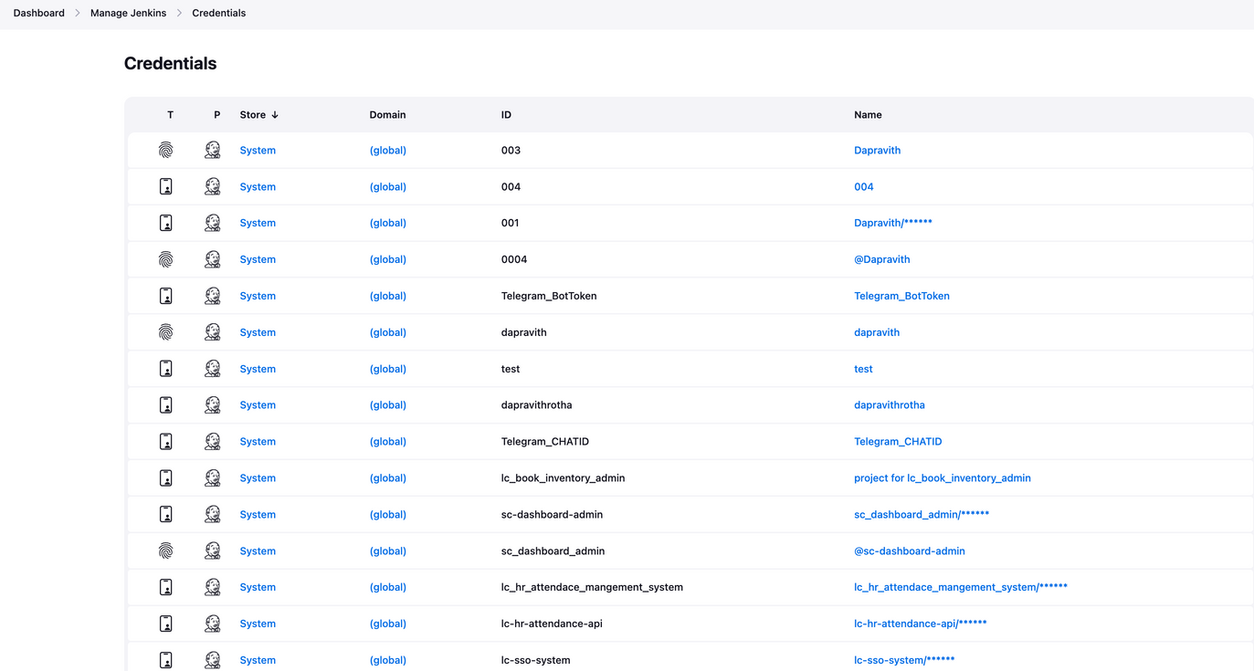
GENERAL PRESENTATION
ANALYSIS AND DESIGN
IMPLEMENTATION
CONCLUSION
DEMONSTRATION
3.2. DevOps Project Implementation
Connect GiLab to Jenkins credentials by access token
Jenkins’s Credentials
21

Slide 22
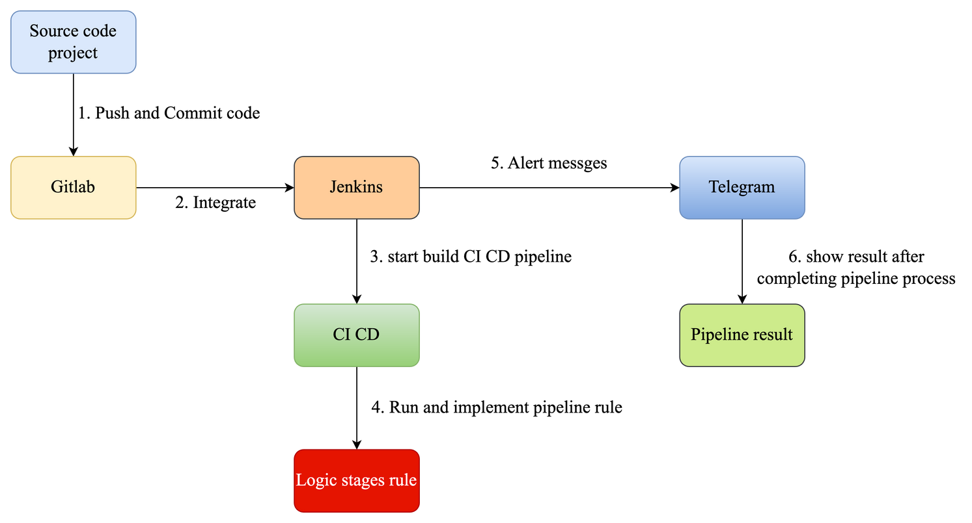
GENERAL PRESENTATION
ANALYSIS AND DESIGN
IMPLEMENTATION
CONCLUSION
DEMONSTRATION
3.2. DevOps Project Implementation
Process of Jenkins Pipeline CI CD
22

Slide 23
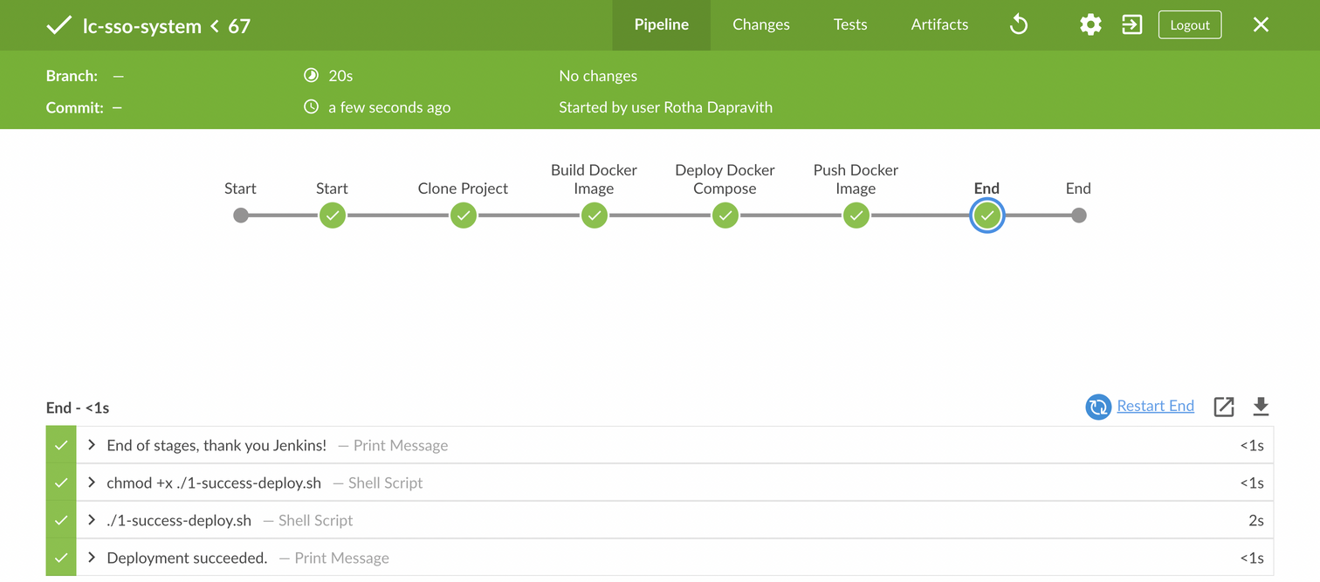
GENERAL PRESENTATION
ANALYSIS AND DESIGN
IMPLEMENTATION
CONCLUSION
DEMONSTRATION
3.2. DevOps Project Implementation
Jenkins blue ocean stage view
23

Slide 24
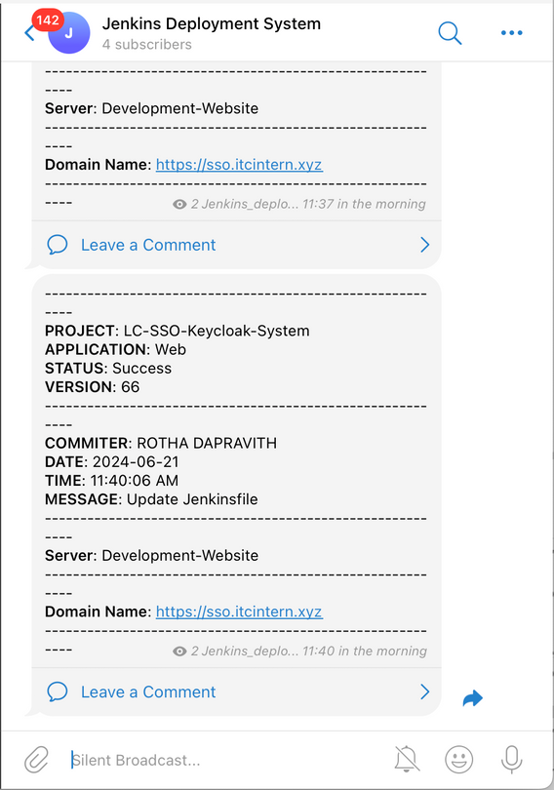
GENERAL PRESENTATION
ANALYSIS AND DESIGN
IMPLEMENTATION
CONCLUSION
DEMONSTRATION
3.2. DevOps Project Implementation
Telegram chat bot alert messages
24

Slide 25

GENERAL PRESENTATION
ANALYSIS AND DESIGN
IMPLEMENTATION
CONCLUSION
DEMONSTRATION
IV. CONCLUSION
25

Slide 26
GENERAL PRESENTATION
ANALYSIS AND DESIGN
IMPLEMENTATION
CONCLUSION
DEMONSTRATION
4.1. Completed and Uncompleted Tasks for SSO System
Tasks | Status | Responsible by
Install and Configure Keycloak Server | Completed | ROTHA Dapravith
User Authentication | Completed | ROTHA Dapravith
Role-Basesd Access Control (RABC) | Completed | ROTHA Dapravith
User Registration | Completed | ROTHA Dapravith
User Profile Management | Completed | ROTHA Dapravith
Administrator Authentication | Completed | ROTHA Dapravith
Session Management | Completed | ROTHA Dapravith
Deployment | Completed | ROTHA Dapravith
Integrate SSO system with another Web Client | In progress | ROTHA Dapravith
26

Slide 27
GENERAL PRESENTATION
ANALYSIS AND DESIGN
IMPLEMENTATION
CONCLUSION
DEMONSTRATION
4.2. Completed and Uncompleted Tasks for DevOps
Tasks | Status | Responsible by
Manage Version Control | Completed | ROTHA Dapravith
Integration CI/CD with Gitlab and Jenkins | Completed | ROTHA Dapravith
Implementation with Docker | Completed | ROTHA Dapravith
Config automation deployment | Completed | ROTHA Dapravith
Configure DNS with Nginx | Completed | ROTHA Dapravith
Implementation with PM2 Server | Completed | ROTHA Dapravith
Notified Message to Telegram | Completed | ROTHA Dapravith
27

Slide 28



GENERAL PRESENTATION
ANALYSIS AND DESIGN
IMPLEMENTATION
CONCLUSION
DEMONSTRATION
4.3. Difficulites
Challenges with new technologies and DevOps.
Have many requirements tasks in project.
Time management.
4.4. Experiences
Real working environments.
Learn new technologies and DevOps.
Know how to deployment on production server.
Self-learning, teamworks and project management.
4.5. Perspectives
Completed with remain tasks.
Secure Microservices with single sign-on system.
Improve performance and security.
28

Slide 29

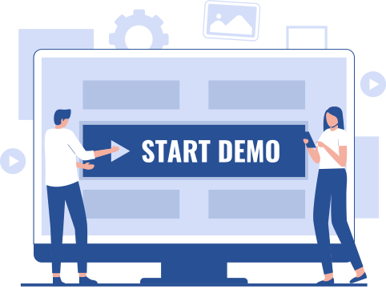
GENERAL PRESENTATION
ANALYSIS AND DESIGN
IMPLEMENTATION
CONCLUSION
DEMONSTRATION
V. DEMONOSTATION
29

Slide 30
GENERAL PRESENTATION
ANALYSIS AND DESIGN
IMPLEMENTATION
CONCLUSION
DEMONSTRATION
THANK YOU FOR YOUR ATTENTION !
30

